Slide 1
SPED OVERVIEW VERIFICATION
Attendance of a SPED Overview is a required part of Credential Application (Checklist Item No.4)
Complete the Google Form Link –
Please take a moment and
complete form now

Slide 2
CSUF Special Education Overview Spring 2024 and Fall 2024

Slide 3
OVERVIEW AGENDA
About the College of Education
About the Department of Special Education
Special Education Admissions
Other SPED Programs & Resources

Slide 4
About the College of Education

Slide 5
Conceptual Framework
The College of Education is committed to the preparation and professional development of innovative and transformative educators who advance just, equitable, and inclusive education. As a professional community of scholar-practitioners, we promote creativity, collaboration and critical thinking as fundamental to student achievement and success in a diverse and interconnected world.

Slide 6
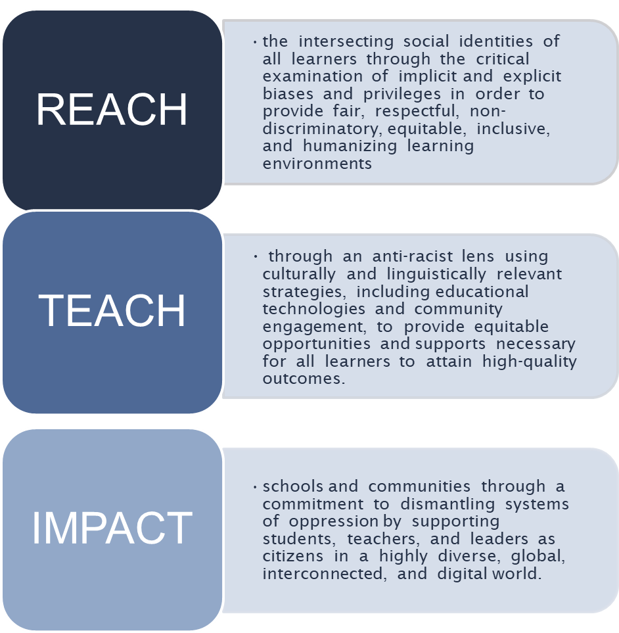
Our Program Completers will…

Slide 7
CSUF Center for Careers in Teaching
CSUF’s academic advising center for future teachers
Most up to date information on California teacher credentialing requirements and recent changes
Follow on linktr.ee/csufcct
Education Classroom Building 379 (EC-379)
657-278-7130 Open M-F 8 am – 5 pm

Slide 8
Special Education Admissions
Lori Sadler, Admissions Coordinator
Email: lsadler@fullerton.edu
Program and course content questions, credentialing, Returning Students
Physical Address
College Park-
Suite 570
2600 Nutwood Ave.
Admissions Assistant
Email:
Phone: (657) 278-4196
General application questions, CSU Apply, Master’s application questions
Mailing Address
P.O. Box 570
Fullerton, CA 98234
Ellie Delgado, Student Assistant
Email: zz-eldelgado@fullerton.edu
Communication re: incomplete paperwork
SPED Department: (657) 278-3350
SPED Department Website: https://ed.fullerton.edu/sped/admissions/cred-sped.php

Slide 9
Special Education Programs

Slide 10
Preliminary Education Specialist Credential Program: Three Emphases
Early Childhood (Dr. Janice Myck-Wayne)
Birth- transitional kindergarten (tk)
Birth-kindergarten if you pass the RICA
Includes mild to moderate and extensive supports needs
Infants, toddlers, young children and families
Mild to Moderate Support Needs (Dr. Tiffany Row)
Grades tk-12 to age 22
Specific learning disabilities; mild to moderate intellectual needs; other health impairments; serious emotional disturbance
Extensive Support Needs (Dr. Erica Howell)
Grades tk-12 to age 22
Severe intellectual needs; multiple disabilities; serious emotional disturbance; deaf-blindness
Notes:
Questions: Universal T-K ?

Slide 11
SPED APPLICATION PROCESS
1
2
3
4
5
Prerequisites:
Take required courses
Application:
Submit through
CSU Apply
Transcripts: Submit to Admissions Office
SPED Dept. Initial File Review
Faculty Interview
University Admissions
All documents
submitted
Pass Faculty Interview
Application Deadlines
Fall 2023
February 15th , March 15th
Spring 2024
September 15th, October 15th

Slide 12
Prerequisite Courses
Special Education
3 classes
ALL applicants
Ethnic Studies
1 class
ALL applicants
Child Development
9 units
Early Childhood ONLY
All pre-reqs must be complete or “in progress” at time application is submitted.

Slide 13
SPED Prerequisite Courses (3 classes) ALL APPLICANTS
Required Observation Hours
Approved
Courses
10 Hours
SPED 322
SPED 371
SPED 425
25 Hours
10 Hours
Minimum Grade
Must receive at least a “C-” or better
Timeline
Valid for 7 years
Where can I take?
CSUF’s Open University
SPED 371 may be offered at local community colleges

Slide 14
SPED Prerequisite Courses ALL APPLICANTS
.
Fall 2023 through Open University
Registration opens August 7, 2023.
Register online through Open University’s website: https://extension.fullerton.edu/ou/fall.aspx Questions? Contact Open University/Extended Ed at eipconnect@fullerton.edu or (657) 278-2611.

Slide 15
Ethnic Studies Prerequisite (1 Course Needed) ALL APPLICANTS
Ethnic Studies
(must complete one from the pre-approved list)
Can be taken at CSUF
OR at a Community College
Must choose from a list of pre-approved classes
Course approved through petition
Ethnic Studies course petitions must be approved by Aimee Nelson at Center for Careers in Teaching
Minimum Grade
“C-” or better
Timeline
Must be taken no later than 10 years prior to entering the credential program

Slide 16
Child Development Prerequisite Courses EARLY CHILDHOOD ONLY*
These 9 units are in addition to 9 units of SPED Prereqs
CAS Courses
9 units of Child Development or
Child Development major
Minimum Grade
“C” or better
Timeline
good for 7 years

Slide 17
SPED Coursework
RESIDENCY REQUIREMENT
75% of all prerequisite and credential coursework must be completed at Cal State Fullerton.
COURSE EQUIVALENCY PETITIONS
If you have taken a course at another University or College that you feel is equivalent to one of the courses in our program, you MUST fill out an equivalency petition before you can be admitted.
Typically, equivalency will be granted only for prerequisite courses
Equivalency Petitions are submitted to the Chair of Special Education, Dr.
Calli Lewis-Chiu at clewischiu@fullerton.edu. Only the Chair of Special Education may approve equivalency petitions.
The SPED Equivalency Petition may be found at
http://ed.fullerton.edu/sped/_resources/pdfs/course-equivalency-petition.pdf

Slide 18
SPED APPLICATION PROCESS
1
2
3
4
5
Prerequisites:
Take required courses
Application:
Submit CSU Apply
SPED Dept. Initial File Review
Faculty Interview
University Admissions

Slide 19
File Checklist Item 1
Create a CSU Apply application

Slide 20
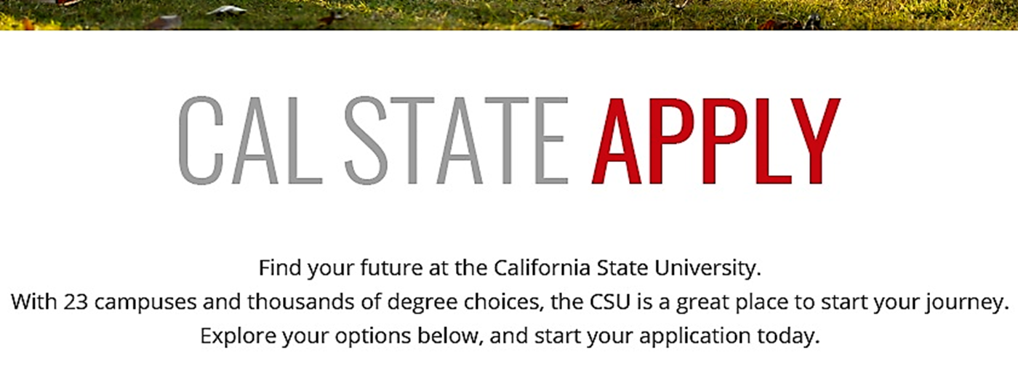
Checklist Item 1: Create Cal State Apply Application
www.calstate.edu/apply

Slide 21
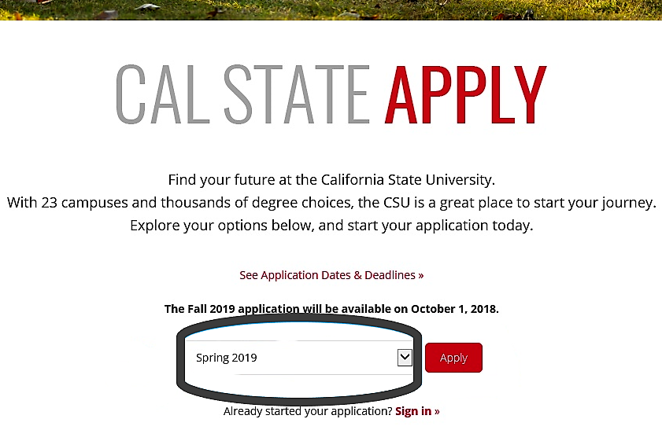
Create Cal State Apply Application by going to: www.calstate.edu/apply
Fall 2023 Applications are now open.
This are needs to be white so it does not affect t
Fall 2023

Slide 22
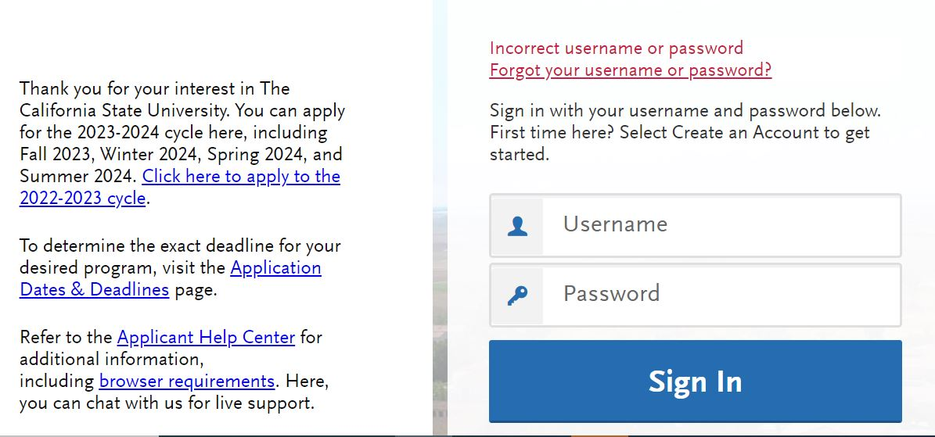
Click “Create an account”

Slide 23
Select “Second Bachelor’s Degree”, then “Teaching and Service Credential Only”
Degree Goal
* What degree, credential, or certificate are you applying for?
First Bachelor’s Degree (Seeking your first bachelor’s degree and
have not earned a prior bachelor’s degree).
Second Bachelor’s Degree and Beyond (e.g. Master’s, Teaching
Credential, Certificate, Doctorate).
* Please select one or more of the following degree goals.
Second Bachelor’s Degree (already earned a bachelor’s degree and are
seeking another one)
Graduate (e.g. Master’s, Doctoral, or Professional’s Degree)
Teaching and Service Credential Only (e.g. Single or Multiple Subject,
Special Education, PPS, Librarian, Admin, CalStateTEACH)
Certificate

Slide 24
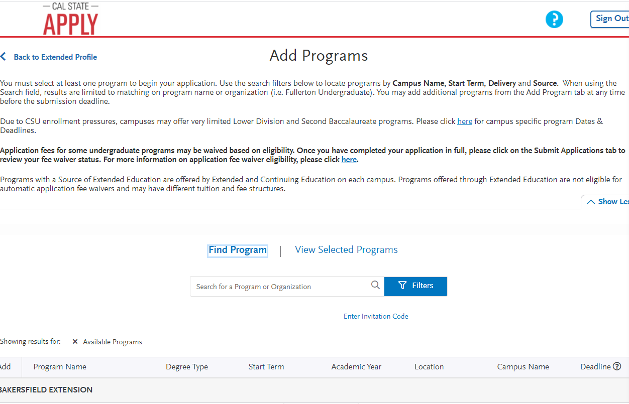
On the “Add Programs” page, click “Filters”

Slide 25
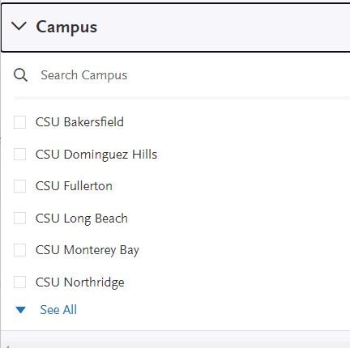
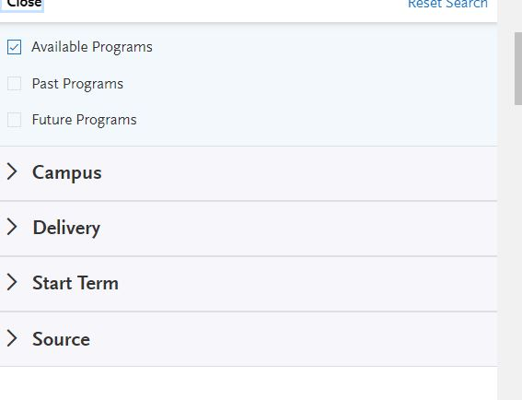
Select “Campus”, then choose “CSU Fullerton”
Select “Campus”
Select “CSU Fullerton’

Slide 26
Choose the program you are interested in

Slide 27
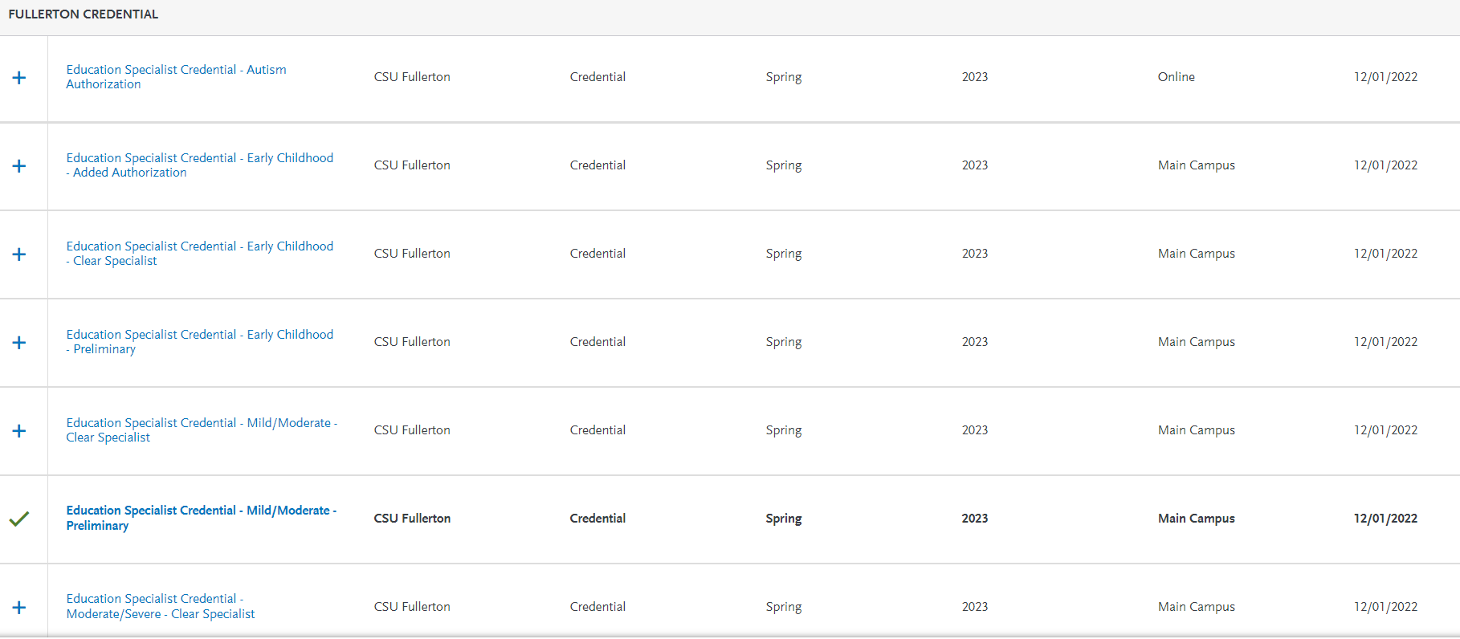
Once you have selected your desired program, click “Continue”. We selected “Education Specialist Credential – Mild Moderate -Preliminary” as an example
Fall
Fall
Fall
Fall
Fall
Fall
Fall

Slide 28
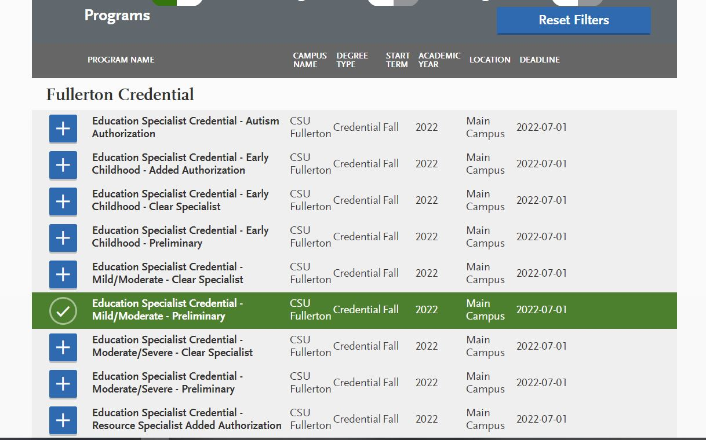
Cal State Apply
You will notice that Cal State Apply has the Fall 2023 deadline as July 1, 2023, however the SPED Department has separate deadlines of February 15, 2023 & March 15, 2023 that students must adhere to when applying to the program.
Fall 2023
7/1/23
Fall 2023
7/1/23
Fall 2023
7/1/23
Fall 2023
7/1/23
Fall 2023
7/1/23
Fall 2023
7/1/23
Fall 2023
7/1/23
Fall 2023
7/1/23
Fall 2023
7/1/23

Slide 29
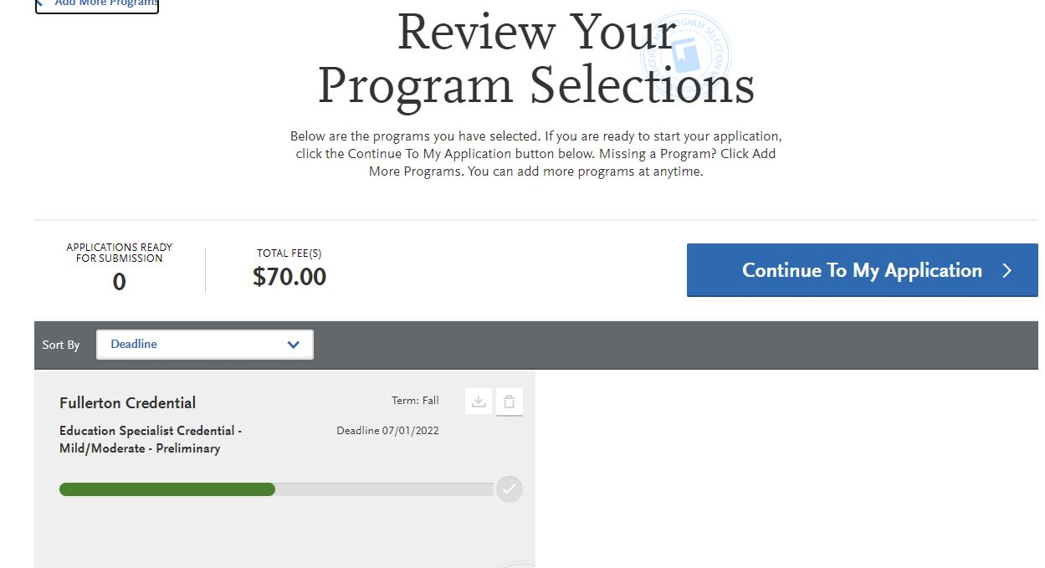
Click “Continue to My Application”
12/01/2022

Slide 30
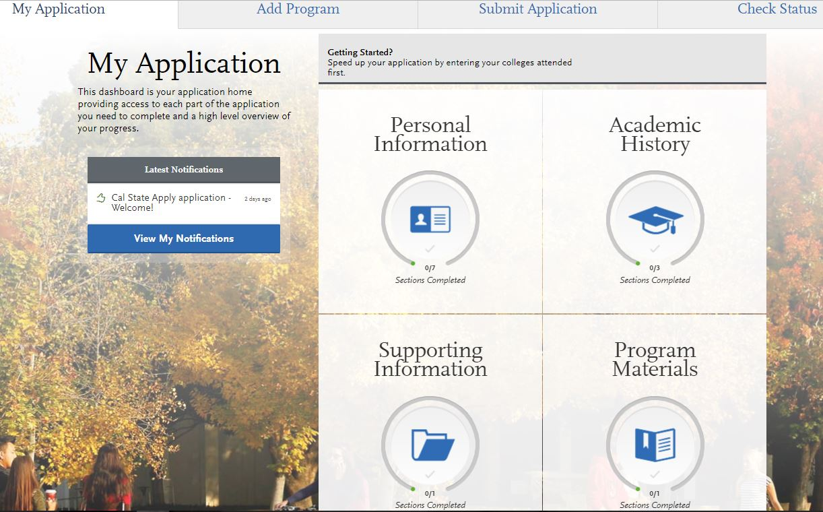
Supporting Information Section: You are NOT required to submit information on your previous work experience. Instead, please select “I am not adding Experiences”. (Instead, please include your work experiences in your Statement of Purpose).
0/7
Sections Completed
0/2
Sections Completed
0/1
Sections Completed
0/1
Sections Completed

Slide 31
This is what the “home” page of Cal State Apply should look like.
0/7
Sections Completed
0/2
Sections Completed
0/1
Sections Completed
0/1
Sections Completed

Slide 32
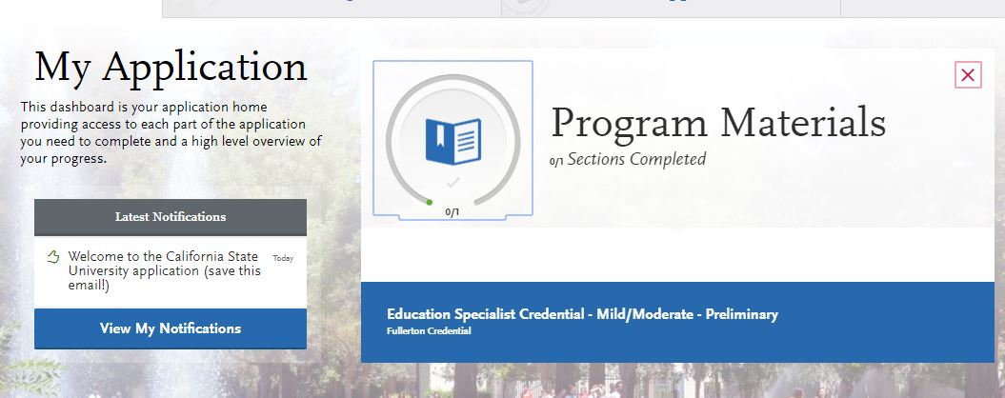
Cal State Apply
PRELIMINARY Application
Program Materials Section
Click the blue box that states, “Education Specialist Credential ______ - PRELIMINARY.”

Slide 33
Cal State Apply
Program Materials Section
Questions Tab - Make sure to answer ALL of the questions in this section. Scroll all the way down to the end of the second scroll bar.

Slide 34
Cal State Apply
Program Materials Section
Click Documents

Slide 35
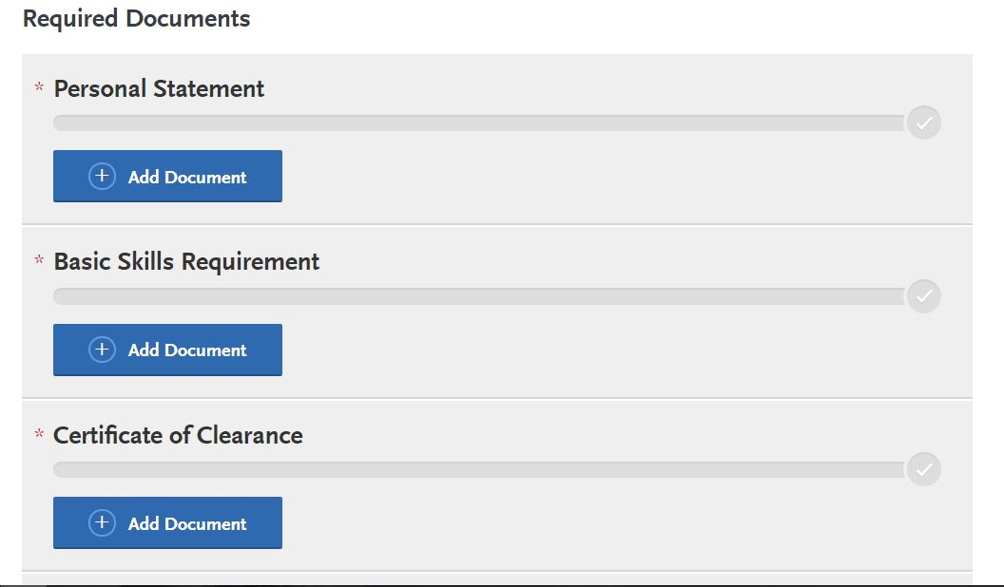
Cal State Apply
PRELIMINARY Application
Program Materials Section
“Documents” section located in the Program Materials Quadrant is where you will upload required documents. This is an image of what the section will begin to look like.
Note: Not all sections are required. Please follow the checklist to determine which sections you need to upload documents.

Slide 36
File Checklist Items #2-15
Upload to CSU Application

Slide 37
Required Application Items: Transcripts to CSU APPLY
FILE CHECKLIST ITEM #2a.
ALL Applicants must upload copies of their official transcripts from the university they received their Bachelor’s Degree from (including CSUF)
Official transcripts must be ordered and mailed directly to the student’s home. Official transcripts must be opened, making them “Unofficial”,
Political Science/Government class at a Community College,
official transcripts from this Community College must be ordered and mailed directly to the student’s home. Official transcripts must be opened, making them “Unofficial”
Upload as PDF to “Program Materials” section, then under “Unofficial Transcripts”.

Slide 38
Required Items: Transcripts to OFFICE OF ADMISSIONS
FILE CHECKLIST ITEM #2b
Applicants must submit official transcripts to CSUF’s Office of Admissions from ALL community colleges and universities you have attended.
If you are a returning CSUF student and you transferred coursework to CSUF when you completed your bachelor’s degree, you will still need to re-send the Office of Admissions copies of your official transcripts from any other Community Colleges or Universities you attended outside of CSUF.
NOTE: CSUF does NOT need CSUF transcripts. They need transcripts from all outside colleges and universities you have attended.
How to submit transcripts to Admissions and Records, please visit:
http://admissions.fullerton.edu/prospectivestudent/college_transcripts.php.

Slide 39
Required Items Checklist Items #3-4: GPA & OVERVIEW
ITEM 3: Grade Point Average (GPA)
2.50 CUMULATIVE (*please note- this information was updated by Executive Order on 3/29/2022);
2.75 last 60 units
We still encourage you to submit an application if you do not currently meet the minimum GPA requirements.
*Office of Admissions verifies your GPA via submitted transcripts
ITEM 4: Program Overview
Applicants will receive an email after completing SPED Overview.
*Be sure to complete the google form today!
FILE CHECKLIST ITEM #3 & 4
Upload Overview Verification to “Program Materials” section, under “Other”.

Slide 40
Required Items Checklist Item #5 – PERSONAL STATEMENT
FILE CHECKLIST ITEM #5 – PERSONAL STATEMENT
Upload 2-3 pages, typed, and double spaced, using the prompt
Prompt topic: Just, Equitable, and Inclusive Education (JEIE)
Include your first and last name in the header.
Upload to “Program Materials” section, under “Personal Statement”.

Slide 41
Required Items Checklist Item #6 – CERTIFICATE OF CLEARANCE
How to check for Certificate of Clearance:
1. Go to the CTC website: | www.ctc.ca.gov
2. Click: | “Search for Educator”
3. Click: | “Secured Search”
4. Input: | Social Security Number and Date of Birth
5. If you are cleared, you will see: | Your name will pop up if you are cleared and it will have the dates your Certificate of Clearance is valid for. (*Certificate of Clearance is valid for 5 years). If you do not see your name and you receive an error message stating, “No records found”, then you will need to complete the Certificate of Clearance, which entails 2 parts.
Upload as one document to “Program Materials” section, under “Certificate of Clearance”.

Slide 42
Required Items Checklist Item #6 – CERTIFICATE OF CLEARANCE
Certificate of Clearance – 2 Steps Needed to complete this Requirement
Step 1. Complete Live Scan Form | Print 2 copies of the Live Scan Form: https://www.ctc.ca.gov/docs/default-source/leaflets/41-ls.pdf?sfvrsn=a1c12202_39. Bring the Live Scan Forms with you to any police station or live scan agency. (You can “Google” Live Scan places nearby and see which one is the closest/cheapest for you). Keep one copy for your records and provide one copy to the CTC address listed on the top of the live scan form.
Step 2. Complete Online Application on CTC website | Go to the CTC website: www.ctc.ca.gov Click the “Educator Login” button (located on the lower right hand side of the page) Click “Create Educator Account” Set up your account Then, complete the “Certificate of Clearance” Answer the Professional Fitness Questions Pay the fee at the end
Documentation: | What the SPED department needs is the document that says you have your Certificate of Clearance. It can be a “Certificate” looking form OR a screenshot from your CTC portal stating you hold your Certificate of Clearance. Upload Certificate of Clearance to Cal State Apply application.
Upload as one document to “Program Materials” section, under “Certificate of Clearance”.

Slide 43
Required Items: Checklist Item #7 BASIC SKILLS REQUIREMENT
Basic Skills Requirement
Options for meeting Basic Skills Requirement:
Pass the CBEST*
Pass the CSET: Multiple Subjects Plus Writing Skills Examination
Pass the CSU Early Assessment Program or the CSU Placement Examinations
Achieve Qualifying Score on the SAT or ACT
College Board Advance Placement (AP) Examinations
Pass a Basic Skills Examination from Another State
Meet the Basic Skills Requirement by Coursework
Meet the Basic Skills Requirement by Coursework and Exam
Must submit official Test Scores
Must complete Basic Skills Verification Form
Upload OFFICIAL TEST RESULTS or complete BASIC SKILLS VERIFICATION FORM and supporting documents to the “Program Materials” section under “Basic Skills”.

Slide 44
Required Items: Checklist Item #8 SUBJECT MATTER COMPETENCE
Subject Matter Competency
There are multiple ways to meet the subject matter competency requirement:
CSET Exam
Select Bachelor’s Degree Majors
State-approved subject matter preparation programs (SSMPP or MSMPP)
Combination of coursework and CSET exams

Slide 45
Required Items: Checklist Item #8 Subject Matter: CSET Exam
If you are meeting Subject Matter through CSET:
You may choose either the Multiple Subject CSET (3 subtests) OR Single Subject CSET (varying numbers of subtests depending on the subject area).
Must pass ALL CSET subtests within the subject area before applying to the program.
NOTE: Even if you sent the results to CSUF, you STILL must upload the results to the Cal State Apply application, as this is the only way the SPED department will be able to review your results.
For multiple subject CSET- upload official tests as ONE document to the “Program Materials” section under “CSET Multiple Subject”.
For Single Subject CSET, upload official tests as ONE document to the “Program Materials” section under “CSET Multiple Subject”.

Slide 46
Required Items: Checklist Item #8 Subject Matter Preparation Program (SSMPP/MSMPP)
If you are meeting Subject Matter through SSMPP/MSMPP
Can be used ONLY if your undergraduate major was in Liberal Studies OR in a core subject area (Math, English, Science, or History).
Must provide signed copy of the completed Multiple Subject Matter Preparation Program (MSMPP) form OR a signed copy of completed Single Subject Matter Preparation Program (SSMPP)
Upload signed MSMPP or SSMPP to “Program Materials” section, under “CSET Multiple Subject”.

Slide 47
Required Items: Checklist Item #9 AMERICAN GOVERNMENT /U.S. CONSTITUTION
FILE CHECKLIST ITEM #9. American Government Course OR U.S. Constitution Exam
Students MUST complete one of the following:
Course- Must receive at least a “C” or higher in an American Government Course. (U.S. History does not count). If you received a “C-“ or lower, you will either need to retake the course OR take the U.S. Constitution Exam.
*Courses are verified via your uploaded transcripts
AP Government Credit- Must be shown on college transcript
*AP exam credit is verified via your uploaded transcripts
U.S. Constitution Exam- Must take and pass an approved exam.
*U.S. Constitution exam credit is verified when you upload exam Completion Certificate to Program Materials, under “Other”.
Course- if you took the Political Science COURSE, upload copies of your official transcripts showing your final grade of “C” or better to “Program Materials” section, under “Unofficial Transcripts”.
U.S. Constitution Exam- If you completed the U.S. Constitution Exam, upload the certificate of completion to “Program Materials” under “Other”.

Slide 48
Required Items: Checklist Item #10-11- TB RESULTS & CPR
FILE CHECKLIST ITEM #10
TB Results - Must be recent within the last 4 years and must remain current throughout the program.
OR
TB Risk Assessment- You may also submit evidence of TB Risk Assessment in place of a TB test.
→ Please fill out the TB Risk Assessment Form, bring to your doctor to sign, then upload to the Cal State Apply application. You can download the risk assessment form here: https://www.cdph.ca.gov/Programs/CID/DCDC/CDPH%20Document%20Library/TBCB-CA-TB-Risk-Assessment-and-Fact-Sheet.pdf
Upload negative TB Results OR completed TB Risk Assessment to the “Program Materials” section, under “Tuberculosis Clearance”.

Slide 49
Required Items: Checklist Item #11- CPR
FILE CHECKLIST ITEM #11- CPR Card
*CPR must be current throughout entire credential program and must meet the following requirements:
Hands-on, Online, or Hybrid courses are accepted.
Must include infant, child, and adult. (Pediatric and Adult is okay too).
Must be certified by either the American Heart Association (AHA) OR the American Red Cross (ARC).
Note: AED and First Aid are NOT required
Upload copy of front and back of signed CPR card OR CPR Certificate to the “Program Materials” section, under “CPR or First Aid Certification”

Slide 50
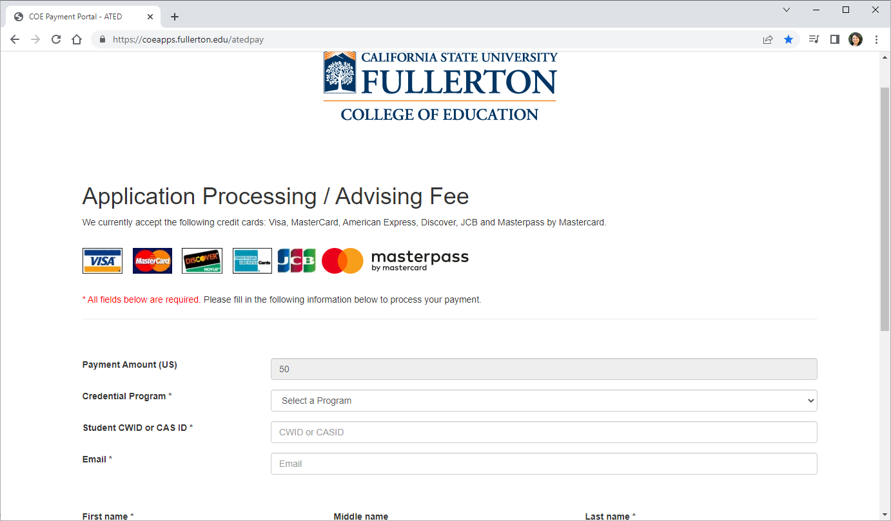
Required Items: Checklist Item #12 – (2) APPLICATION FEES NEEDED
1) Pay $50 Department Processing Fee at College of Ed Payment Portal
You will need your CWID or CAS ID (CSU Apply Applicant ID)
https://coeapps.fullerton.edu/atedpay
2) Pay $70 CSU Application fee in the CSU Apply portal
Upload receipt for $50 Department Fee to the “Program Materials” section, under “Other”.

Slide 51
Required Items Checklist Item #14 - Letters of Recommendation
Faculty (2)
http://fullerton.qualtrics.com/jfe/form/SV_bwqbXQAEzKJJw0K
Four (4) letters TOTAL
Must be submitted via CONFIDENTIAL LINK
Letters are valid for one year from the date they are written.
Child/Youth (2)
http://fullerton.qualtrics.com/jfe/form/SV_bPC55Oi9V7W1lu6.

Slide 52
CHECK FOR ACCREDITED DEGREE!
Check for Accredited Degree- If you graduated from a Cal State (CSU) or a UC, you have already met this requirement.
Ensure your bachelor’s degree is from a regionally accredited university accepted by the CTC (2 steps).
Step 1: Check your university accreditation status here: https:ope.ed.gov/dapip/#/home
Step 2: After you have checked your accreditation status, you will need to check to see if the CTC accepts this accrediting university: https://www.ctc.ca.gov/credentials/what-does-regional-accreditation-mean
For further questions about this process, please contact CSUF’s Credential Preparation Center at (657) 278-3205 or credentialsonline@fullerton.edu

Slide 53
SPED APPLICATION PROCESS
1
2
3
4
5
Prerequisites:
Take required courses
Application:
Submit CSU Apply
SPED Dept. Initial File Review
Faculty Interview
University Admissions
Faculty Interview is granted once all file items are complete.

Slide 54
Other Programs

Slide 55
INTERNATIONAL STUDENTS
If you are an International Student, please be sure to seek advisement from International Student Services. International Student Services provides advising to international students on F or J status on immigration, personal, social and cultural matters.

Slide 56
Intern Program
The purpose of the intern program is to allow teachers in high-need subject areas to begin teaching right away, while earning a credential, with extensive support from faculty and mentor teachers.
Deadline to become an Intern:
Fall - July 31st
Spring - December 31st

Slide 57
Intern Program
WITH CREDENTIAL If you hold a single credential or multiple subject credential, 2 Requirements Complete program prerequisites Pass faculty interview. |  | NO CREDENTIAL If you do not have a single subject or multiple subject credential, 4 Requirements Complete program prerequisites Pass faculty interview. SPED 421 and Complete one of the following: SPED 400 for EC or SPED 463 for MMSN or SPED 464 for ESN
2 Paths

Slide 58
Intern Program – Responsibilities as an Intern
Once you are “intern ready”, it will be up to you to find an intern position.
Some districts posts positions as “intern positions”, while others post them as regular teaching positions.
As an intern, you will have your own classroom.
You will be responsible for IEP’s, writing goals, lesson plans, parent meetings, etc.
You will have a mentor teacher on site to support you.

Slide 59
Intern Program – Responsibilities as an Intern
You will have a supervisor from CSUF to support you.
As an intern, you will take the same courses as someone doing the “traditional” student teaching route.
As an intern, you will be expected to enroll in SPED 490 each semester you are an intern.

Slide 60
MSE Concentration in Special Education
Prepares you for leadership roles in schools
Advances your skills in using research to improve teaching and learning
Increases your earning power in birth-adult education settings, as well as in higher-education
Check out Master of Science in Special Education website and Youtube video
http://ed.fullerton.edu/sped/master_of_science_special_education/index.php

Slide 61
Bilingual Authorization
Available in Spanish, Korean, Vietnamese and Mandarin.
CONTACT: Dr. Fernando Rodriguez-Valls at frodriguez-valls@fullerton.edu.
Hola!
Anyong!
Chao!
Nihao!

Slide 62
Resources

Slide 63
Scholarships and Financial Aid
Tuition and Fee Information
College of Education Scholarships
Grant and Scholarship opportunities
https://sfs.fullerton.edu/services/fees/TuitionAndCampusFees.php
Check Student Financial Services for Credential and Master’s Program fees
http://ed.fullerton.edu/current-students/financial-aid.php
Financial Aid
Complete DREAM ACT application
Deadline: March 2
https://dream.csac.ca.gov/.
Complete FAFSA application
Deadline: March 2
www.fafsa.ed.gov
DREAMER Student Resources
Notes:
Kim Case, Assistant Dean in the College of Ed- She can assist you with scholarships/grants specifically for educators. She can also provide you with information regarding vouchers for the CBEST and/or CSET.
Kim Case : 657.278.3777 or kcase@fullerton.edu

Slide 64
Application Checklist and Program Plans Program Plans: Early Childhood:
Links to Resources such as, Application Checklist, Mild to Moderate Support Needs Program Plan, Extensive Support Needs Program Plan and Early Childhood Program Plan, can be found on the Resources page of the SPED website: https://ed.fullerton.edu/sped/student-resources/

Slide 65
Important Links
SPED Department: http://ed.fullerton.edu/sped/
SPED Admissions: http://ed.fullerton.edu/sped/admissions.php
University admissions: www.calstate.edu/apply
$50 Department Processing Fee: https://coeapps.fullerton.edu/atedpay
Certificate of Clearance: https://www.ctc.ca.gov/credentials/leaflets/certificate-of-clearance-(cl-900)
CBEST: www.cbest.nesinc.com
CSET: www.cset.nesinc.com
Open University: http://ou.fullerton.edu/
Extended Ed: http://extension.fullerton.edu/professionaldevelopment/Educators
CSUF Career Center: www.fullerton.edu/career
California Commission on Teacher Credentialing: www.ctc.ca.gov
Center for Careers in Teaching: www.fullerton.edu/cct
Financial Services: http://sfs.fullerton.edu

Slide 66
Your Success is Your Responsibility
Submit all documentation-
To avoid delays in processing of your application, be sure to submit all documentation on Cal State Apply application!
Submit transcripts to 1)Admissions and 2) Upload to CSU Apply
Make sure you have submitted transcripts for ALL universities attended to CSUF’s Admissions Office AND second set of transcripts to the Cal State Apply application.
Keep Copies

Slide 67
Thank you!

