Slide 1
Special Education Program Overview
Education Specialist Credential Programs
Master of Science in Education- Concentration
in Special Education
Department of Special Education, revised August 2020

Slide 2
Overview Agenda
College of Education Conceptual Framework
The Admissions Process
Preliminary Credential Program
- Mild/Moderate, Moderate/Severe and Early Childhood Special Education
- Subject Matter Preparation, Prerequisite Coursework, Credential Program,
Coursework and Directed Teaching
Internship Program
Bilingual Authorization
Clear Credential Program
MSE Graduate Program

Slide 3
College of Education Conceptual Framework
Mission Statement
Our mission is to teach, to serve, and to engage in scholarship.
We teach our students to be critical thinkers and lifelong learners
We prepare professionals who improve student learning, promote diversity, make informed decisions, engage in collaborative endeavors, maintain professional and ethical standards, and become change agents in their workplaces.
We engage in scholarly work that informs the profession and we serve the education community by providing applied scholarship.

Slide 4
Our Program Completers Are:
Knowledgeable and Competent Specialists who
demonstrate strong foundation in subject matter
Reflective and Responsive Practitioners who
promote diversity
engage in collaborative endeavors
Committed and Caring Professionals who
become change agents
maintain professional and ethical standards
demonstrate ability to use technology as a resource
demonstrate strong understanding and implementation skills in the field
think critically and make informed decisions
become life-long learners

Slide 5
SPED Admissions Staff and Faculty
Physical Address:
- 2600 E Nutwood Ave. Fullerton, CA 92831
Mailing Address:
- P.O. Box 6868- CP-540, Fullerton, CA 92834
Admissions Coordinator:
- Lori Sadler, MS, lsadler@fullerton.edu
Admissions Administrative Support Specialist:
-Lisa Alexander lalexander@fullerton.edu CP 540 ; (657) 278-4196
Department of Special Education Website:
- http://ed.fullerton.edu/sped/admissions/cred-sped.php

Slide 6
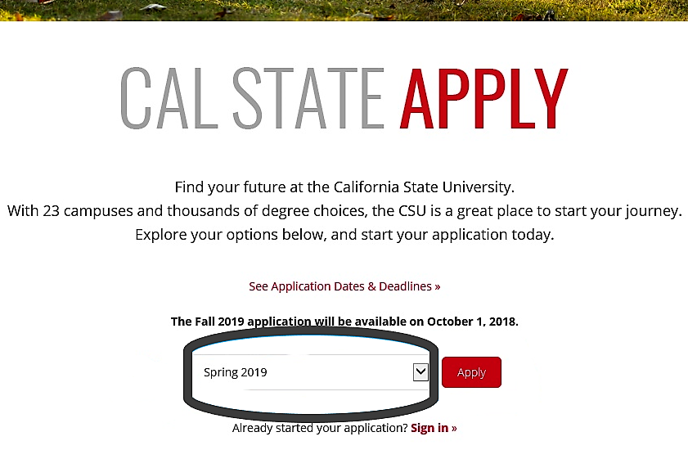
Cal State Apply
Create Cal State Apply Application by going to: www.calstate.edu/apply
This are needs to be white so it does not affect t
Spring 2021

Slide 7
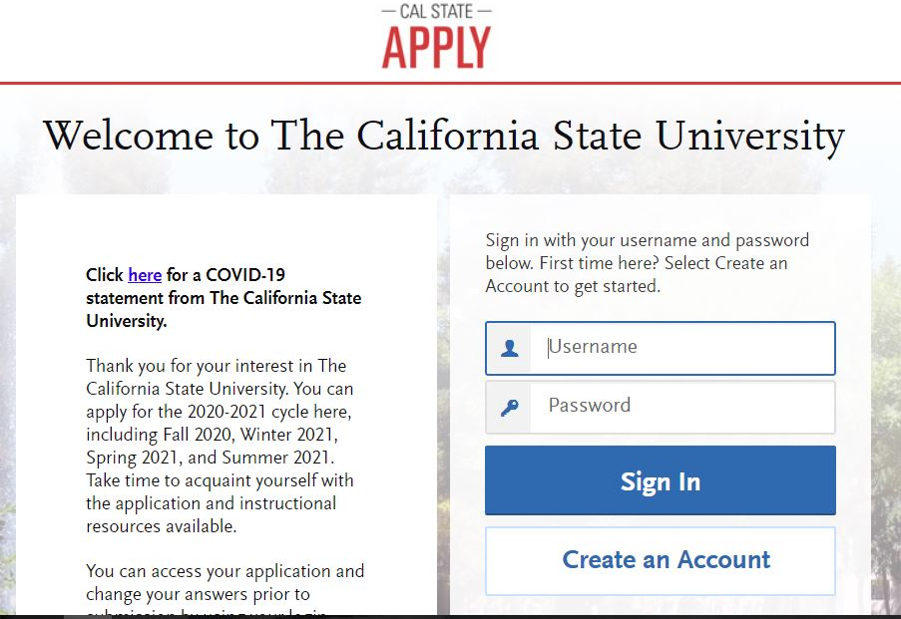
Cal State Apply
Click “Create an account”

Slide 8
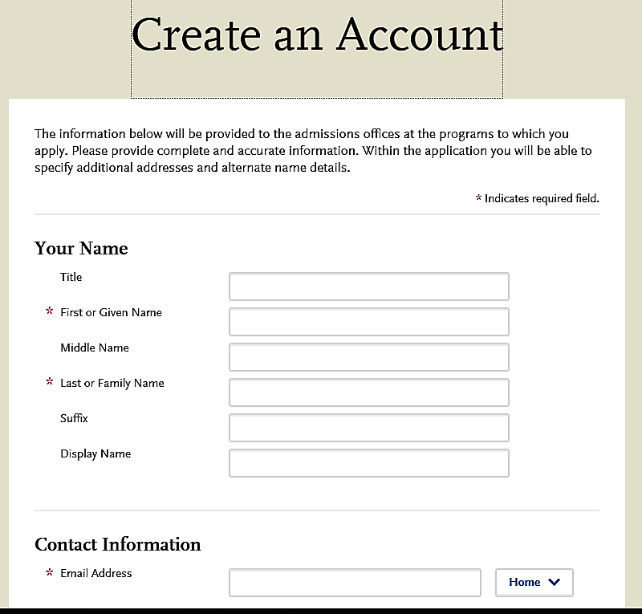
Cal State Apply
Input your name and contact information
Title
First or Given Name
Middle Name
Last or Family Name
Suffix
Display Name

Slide 9
Cal State Apply
Input username and password

Slide 10
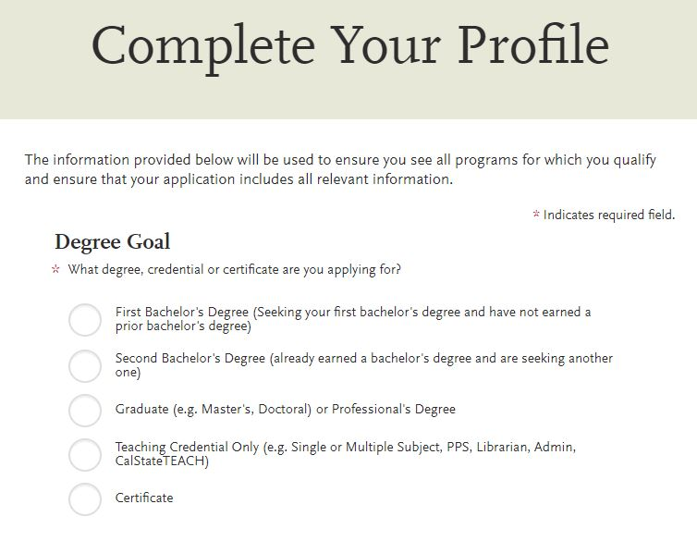
Cal State Apply
Select “Teaching Credential Only”
The information provided below will be used to ensure you see all programs for which you qualify and ensure that your application includes all relevant information.
* Indicates required field.
* What degree, credential or certificate are you applying for?
First Bachelor’s Degree (Seeking your first bachelor’s degree and have not earned a prior bachelor’s degree)
Second Bachelor’s Degree (already earned a bachelor’s degree and are seeking another one)
Graduate (e.g. Master’s, Doctoral) or Professional’s Degree
Teaching Credential Only (e.g. Single or Multiple Subject, PPS, Librarian, Admin, CalState TEACH)
Certificate

Slide 11
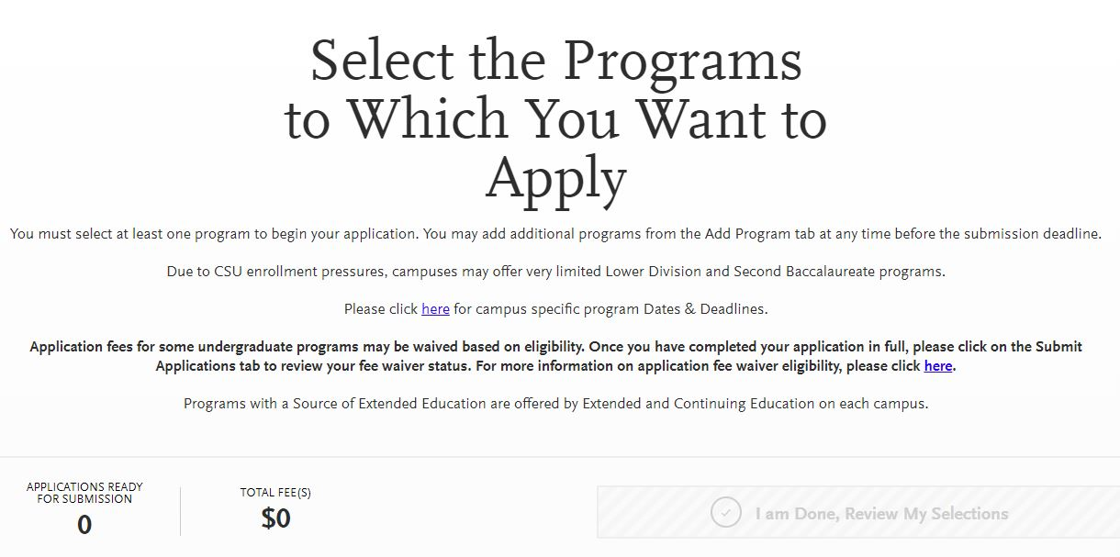
Cal State Apply
Scroll down to select program

Slide 12
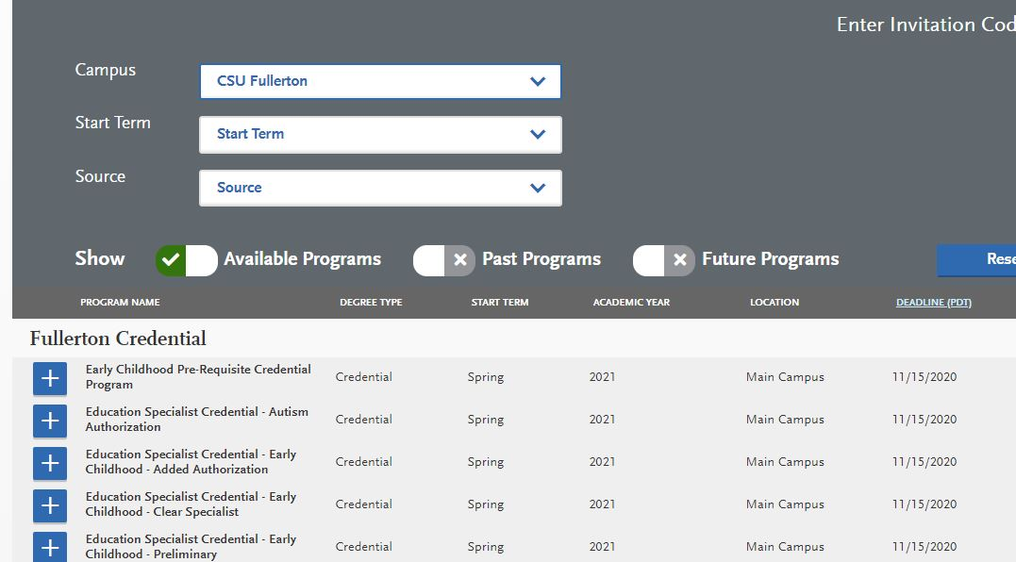
Cal State Apply
For the “Campus” section, choose CSU Fullerton

Slide 13
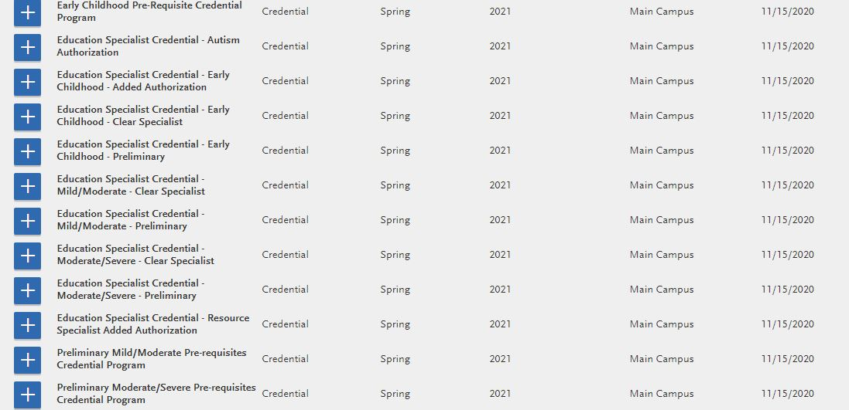
Cal State Apply
If you have NOT taken the SPED pre-reqs, apply to ONE of the PRE-REQUISITE Programs, in either:
1) Early Childhood Pre-requisite, 2) Preliminary Mild Moderate PRE-REQUISITE, or 3) Preliminary Moderate Severe PRE-REQUISITE.

Slide 14
If you have taken the SPED pre-reqs (or are currently taking them, select PRELIMINARY Early Childhood, Mild Moderate, or Moderate Severe.
Cal State Apply

Slide 15
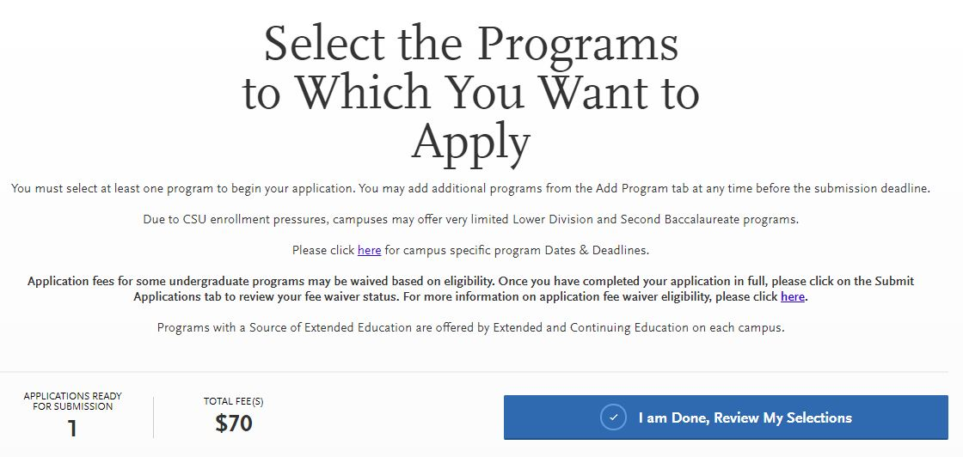
Cal State Apply
Once you have chosen the correct program, select “I am Done, Review My Selections”

Slide 16
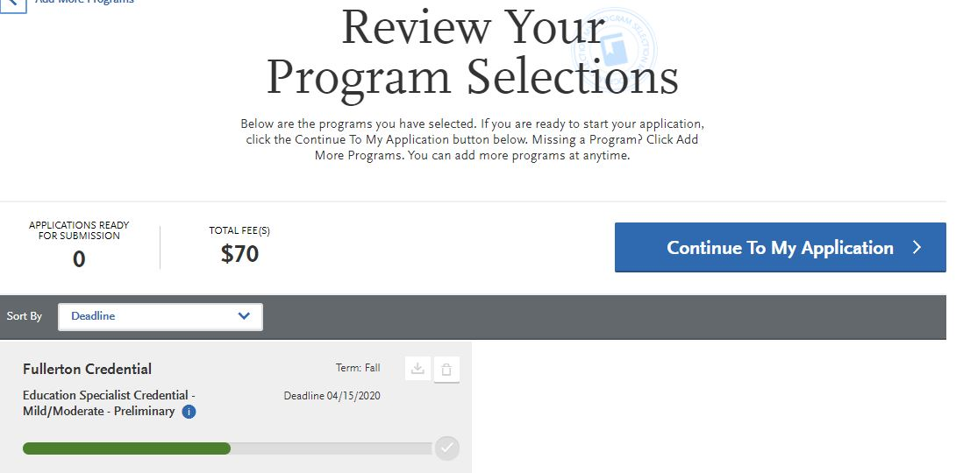
Cal State Apply
Click “Continue to My Application”
Deadline 11/15/20

Slide 17
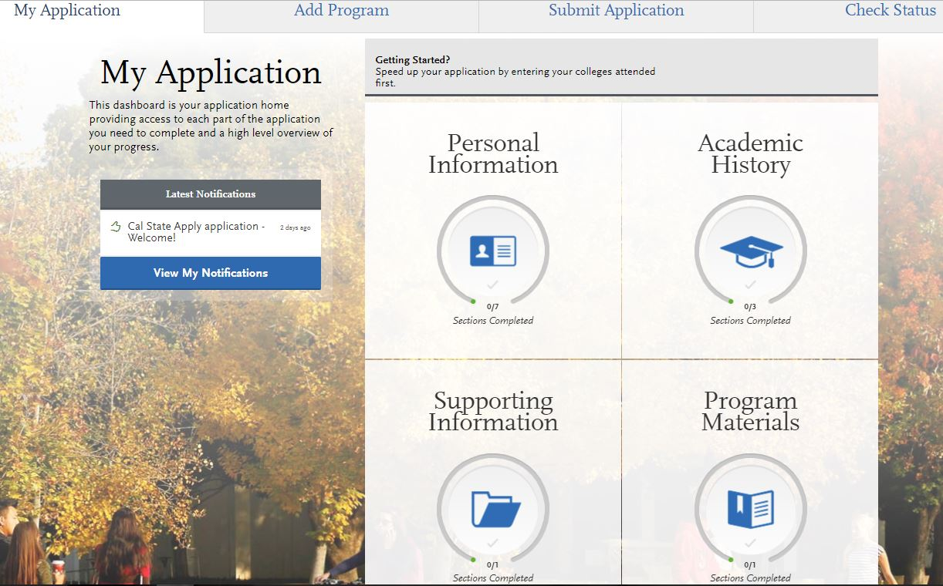
Cal State Apply
This is what the “home” page of Cal State Apply should look like.
0/7
Sections Completed
0/3
Sections Completed
0/1
Sections Completed
0/1
Sections Completed

Slide 18
Cal State Apply
[Q1]

Slide 19
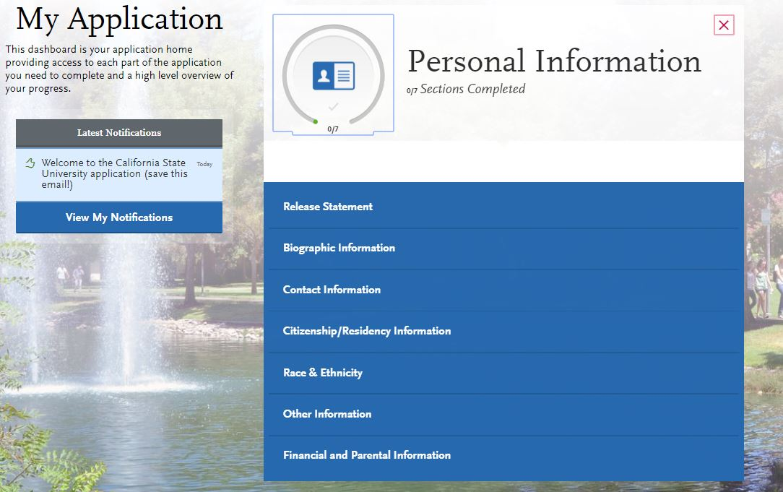
Cal State Apply
[Q1]- Personal Information Section

Slide 20
Cal State Apply
Please SKIP the following sections on the Cal State Apply Application
Standardized Tests
In the “Academic History” section in [Q2], please SKIP the Standardized Tests section. This section asks for test scores such as the GRE, SAT, and ACT, which are NOT needed for the SPED credential program. In order to skip this section, please select, “I am not adding any standardized tests.”
Experiences
In the “Supporting Information” section in [Q3], please SKIP the Experiences section. In order to skip this section, please select, “I am not adding any experiences.”

Slide 21
Cal State Apply
[Q2]

Slide 22
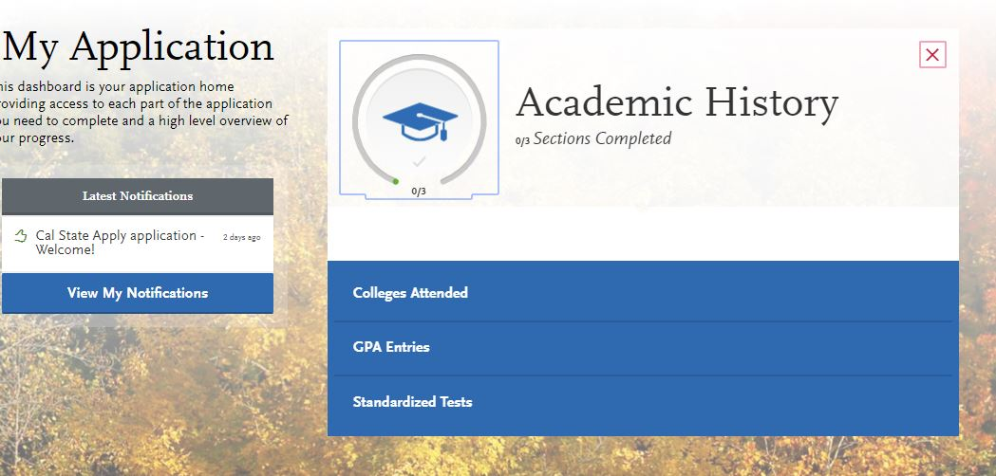
Cal State Apply
[Q2]- Academic History Section- Standardized Tests
Standardized Tests- All of the tests listed in this section are NOT needed for the credential program. Please select “I am not adding any standardized tests”.

Slide 23
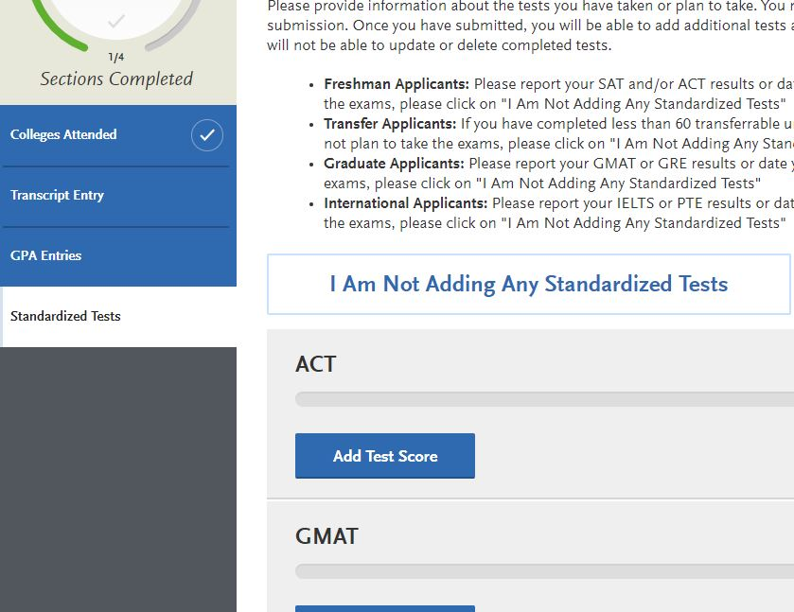
Cal State Apply
[Q2]- Academic History Section- Standardized Tests

Slide 24
Cal State Apply
[Q3]

Slide 25
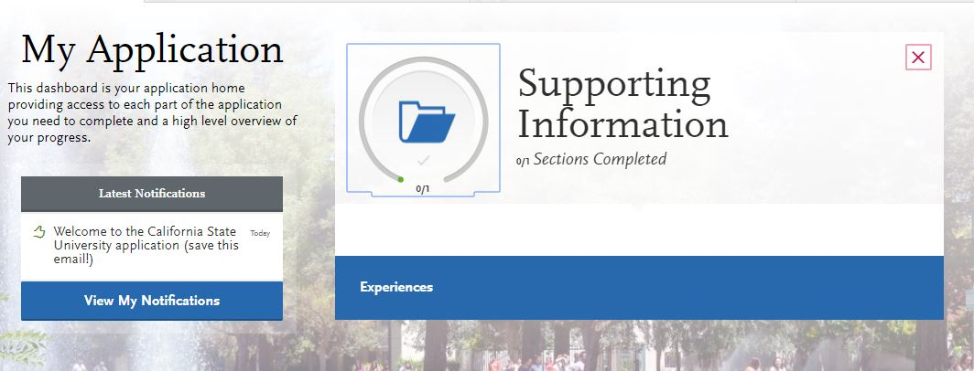
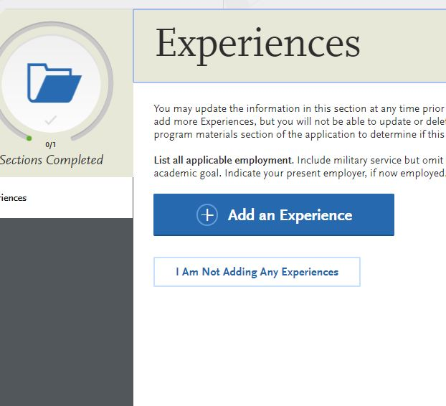
[Q3]- Supporting Information Section
Cal State Apply
Click the blue “Experiences” button
Then, click “I am not adding any experiences”
I am Not Adding any Experiences

Slide 26
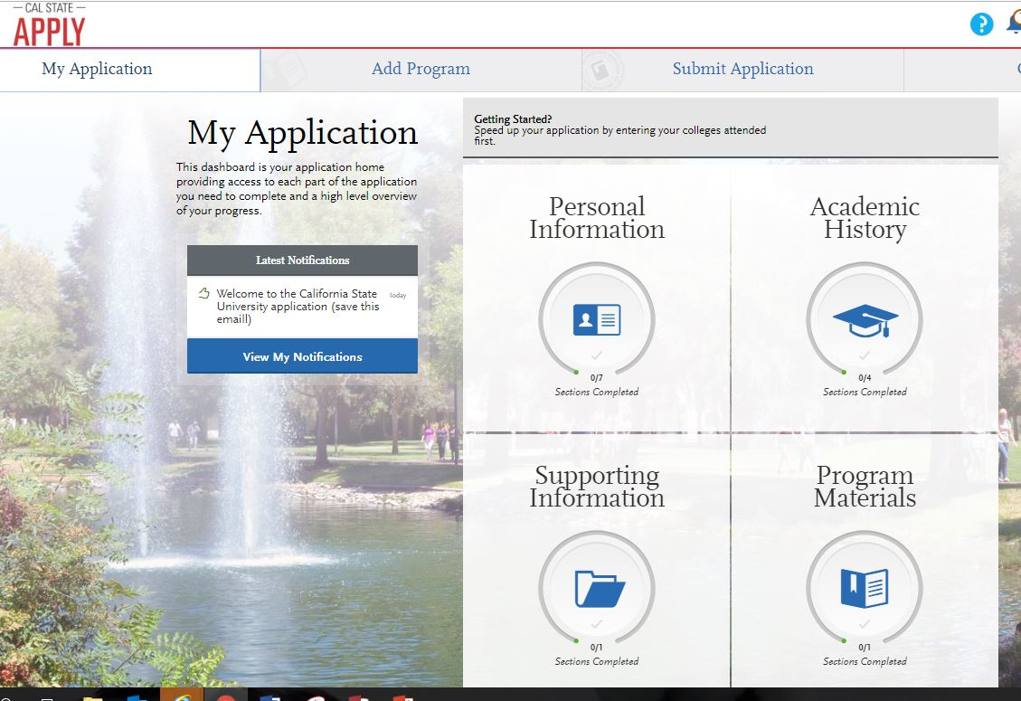
Cal State Apply
[Q4]

Slide 27
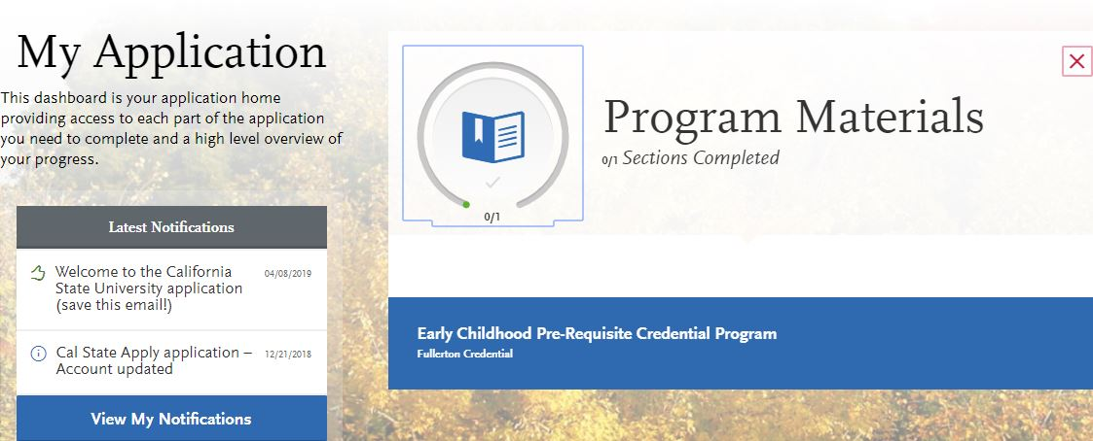
Cal State Apply
PRE-REQUISITE Application
[Q4]- Program Materials Section
Click the blue box that states,
“___ PRE-REQUISITE.”

Slide 28
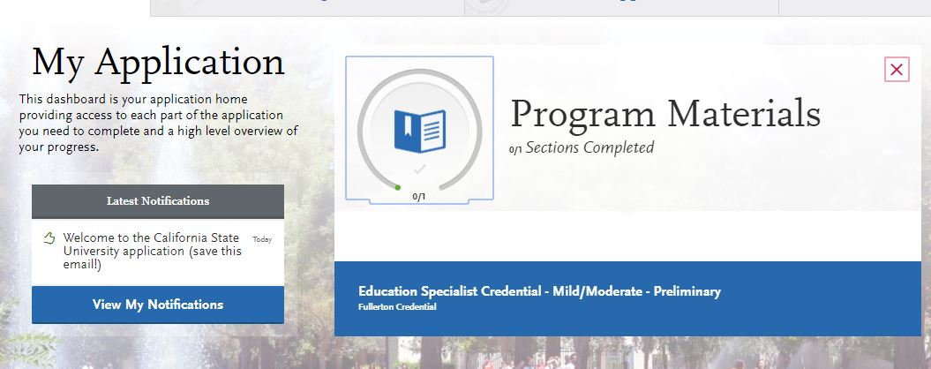
Cal State Apply
PRELIMINARY Application
[Q4]- Program Materials Section
Click the blue box that states, “Education Specialist Credential ______ - PRELIMINARY.”

Slide 29
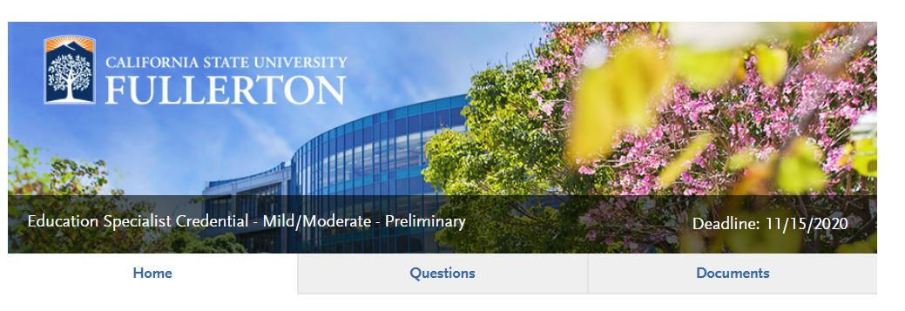
Cal State Apply
[Q4]- Program Materials
Click Documents

Slide 30
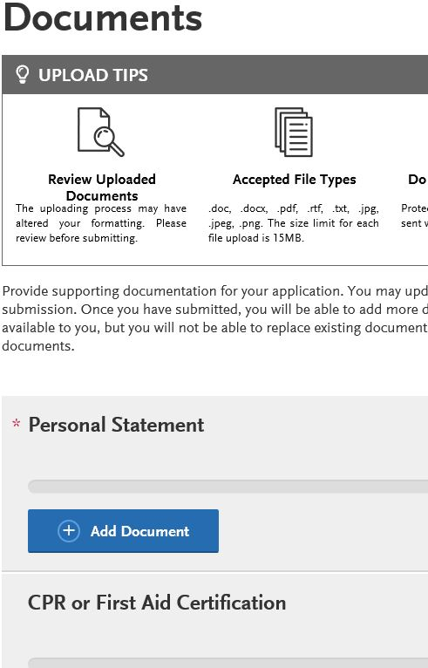
Cal State Apply
PRELIMINARY Application
[Q4]- Program Materials
In the “Documents” section in [Q4] is where you will upload the required documents for this section. This is an image of what the section will begin to look like.
Note: Not all sections are required. Please follow the checklist to determine which sections you need to upload documents.

Slide 31
Admission Requirements
Attendance of an overview is required.
You will receive an overview verification email verifying your attendance of an overview within one week after attendance.
To show verification of this requirement, please refer to #4 on the checklist.
University graduate application submitted – www.calstate.edu/apply
Transcripts for ALL Colleges and Universities attended:
-Official, Sealed Transcripts- for both University & Program applications.
Note: Refer to checklist for instructions on how to submit transcripts.

Slide 32
Admission Requirements
GPA Requirement:
- Credential GPA 2.75 in last 60 units OR cumulative
- Master’s GPA: 3.0 in last 60 units
Personal Statement- Please share your experiences working with children in both educational and community settings. Please also include your experience with culturally and linguistically diverse populations and your long term goals in working in the field of special ed.
(2-3 pages in length, typed and double spaced.) Please write your first and last name in the header.
Certificate of Clearance: (2 parts)
Live Scan
Online Application on the CTC website
Please visit their website for more info:
http://www.ctc.ca.gov/credentials/leaflets/c1667.pdf

Slide 33
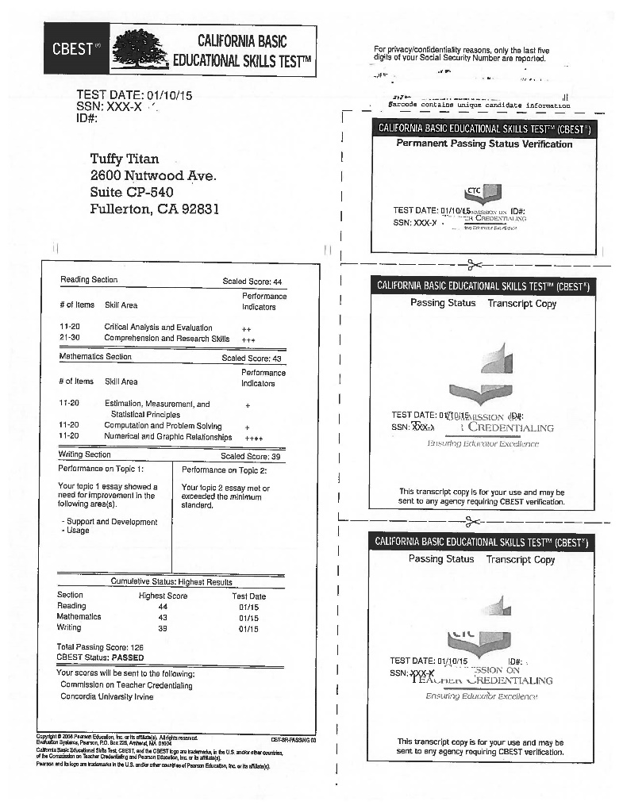
Admission Requirements
Passage of California Basic Educational Skills Test (CBEST): www.cbest.nesinc.com.
For other ways to meet the basic skills requirement, visit: http://www.ctc.ca.gov/credentials/leaflets/cl667.pdf.
Sample of CBEST results page. Please upload the entire results page to the Cal State Apply application.

Slide 34
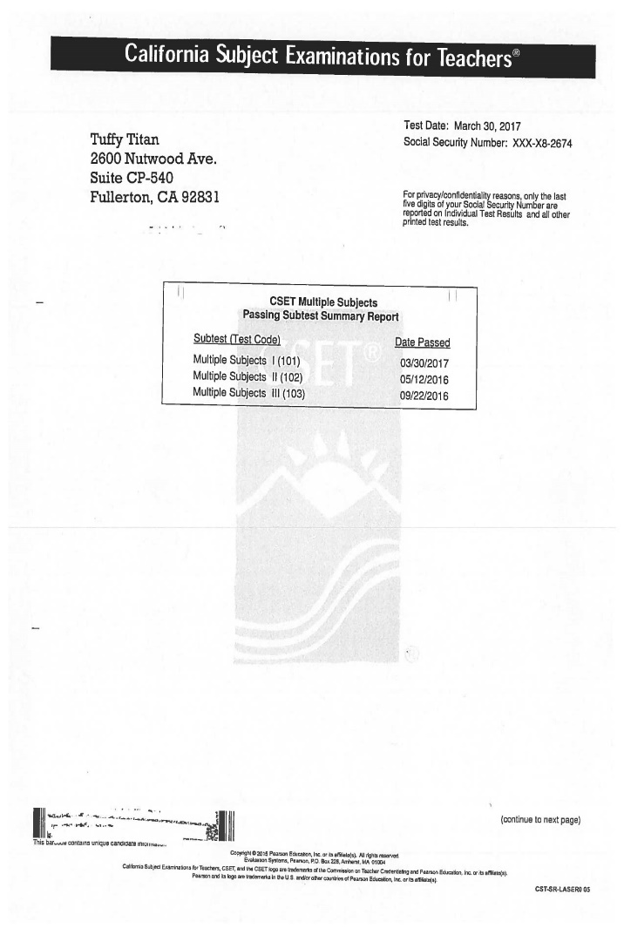
Admission Requirements
Subject Matter Competency-
CSET or SSMPP/MSMPP (Required for MM & MS)
K-6: Multiple Subject CSET
7-12: Single Subject CSET (in approved subject area)
Recommended: English, Math, FLM, FLS, History. Please refer to checklist for more options
.
Note: CSET is NOT required for EC, however 9 units of Child Development Coursework are required in place of the CSET.
Sample of CSET results page that needs to be uploaded to the Cal State Apply application. (**Notice: Please upload the results page with ALL of the subtests listed on ONE page.

Slide 35
Admission Requirements
American Government Course OR U.S. Constitution Exam
Students MUST complete one of the following:
Political Science/Government Course OR U.S. Constitution Exam
Please refer to the checklist for more detailed information regarding requirements and how to show verification of this requirement.

Slide 36
Admission Requirements
TB test
Must be recent within the last 4 years
Must be valid throughout the entire program
-if you are a current student, it can be done at the Health Center
Current CPR card- (Infant, Child and Adult required)
You may choose any hands-on course OR an online course offered either by the American Heart Association or the American Red Cross
$50 Department Processing Fee
(This fee is separate from the $70 university fee.
Can be paid one of the following ways:
In person at the cashier’s office in GH- 180
Online via: https://coepay.fullerton.edu/ated
Please refer to checklist on how to show verification of this requirement.

Slide 37
Admission Requirements
4 letters of recommendation (current, within one year):
- 2 from Faculty- (templates available on the website)
- 2 from Child/Youth Experience- (templates available on
the website)
- All letters of recommendation are confidential.
Check for Accredited Degree- If you graduated from a Cal State (CSU) or a UC, you have already met this requirement.
Ensure your bachelor’s degree is from a regionally accredited university accepted by the CTC (2 steps).
Step 1: Check your university accreditation status here: https:ope.ed.gov/dapip/#/home
Step 2: After you have checked your accreditation status, you will need to check to see if the CTC accepts this accrediting university: https://www.ctc.ca.gov/credentials/what-does-regional-accreditation-mean
For further questions about this process, please contact CSUF’s Credential Preparation Center at (657) 278-3205 or credentialsonline@fullerton.edu

Slide 38
Admission Requirements
SPED Pre-requisites: Required for ALL programs (EC, MM, & MS)
Observation Hours Required
SPED 322: 10 Hours Required
SPED 371: 5 Hours Required
SPED 425: 30 Hours Required
CAS Pre-requisites: Required for Early Childhood ONLY
A minimum of 9 units of child development coursework is only required for those beginning the Early Childhood Credential Program.
The 9 units are in addition to completing the 3 SPED Pre-reqs.
(Please refer to the checklist for more information)
Passing Faculty Interview
-Granted when application is complete

Slide 39
Application Checklist: http://ed.fullerton.edu/sped/_resources/pdfs/F19_Preliminary_Special_Education_Credential_Program_Checklist.pdf Program Plans: Mild/Mod: http://ed.fullerton.edu/sped/_resources/pdfs/preliminary-education-specialist-credential-mildmoderate.pdf Moderate/Severe: http://ed.fullerton.edu/sped/_resources/pdfs/preliminary-education-specialist-credential-moderatesevere.pdf
Documents to Print
Early Childhood: http://ed.fullerton.edu/sped/_resources/pdfs/credential_program_plan_early_childhood_special_eduation.pdf

Slide 40
Credential Program Coordinators
Early Childhood Program Coordinator
Dr. Janice Myck-Wayne
jmyck-wayne@fullerton.edu
Moderate/Severe Program Coordinator
Dr. Erica Howell
ehowell@fullerton.edu
Mild/Moderate Program Coordinator
Dr. Tiffany Row
trow@fullerton.edu

Slide 41
Intern Program
The purpose of the intern program is to allow teachers in high-need subject areas to begin teaching:
right away
while earning a credential
with extensive support
Intern Program requirements
There are two pathways to becoming an intern:
1. If you hold a single credential or multiple subject credential, have completed our program prerequisites and have successfully passed the faculty interview.
2. If you do not have hold a single subject or multiple subject credential, you will need to complete the three prerequisites as well as SPED 421 and one of the following: SPED 400 for EC, SPED 463 for MM or SPED 464 for MS. In addition, you will need to successfully pass the faculty interview.

Slide 42
Residency Requirements
75% of all prerequisite and credential coursework must be completed at Cal State Fullerton.
If you have taken a course at another University or College that you feel is equivalent to one of the courses in our program, you MUST fill out an equivalency petition before you can be admitted.
-Typically, equivalency will be granted only for prerequisite courses
- The SPED Equivalency Petition may be found at
http://ed.fullerton.edu/sped/_resources/pdfs/course-equivalency-petition.pdf
-Equivalency Petitions are submitted to the Chair of Special Education, Dr. Melinda Pierson. Only the Chair of Special Education may approve equivalency petitions.

Slide 43
Clear Program
Once you have completed a Preliminary credential program, you can choose to complete our clear program.
The clear advisors are:
-Dr. Tiffany Row- Mild/Moderate
-Dr. Erica Howell- Moderate/Severe
-Dr. Janice Myck-Wayne- Early Childhood

Slide 44
Bilingual Authorization
Available in Spanish, Korean, Vietnamese and Mandarin.
For more information, please contact Dr. Fernando Rodriguez-Valls at frodriguez-valls@fullerton.edu.
Hola!
Anyong!
Chao!
Nihao!

Slide 45
MSE Concentration in Special Education
Prepares you for leadership roles in schools
Advances your skills in using research to improve teaching and learning
Increases your earning power in birth-adult education settings, as well as in higher-education
Graduate Program Coordinator:
- Adrian Jung, Ph.D., ajung@fullerton.edu, CP 570

Slide 46
MSE Requirements
GPA of 3.0 or above & Official Transcripts
Three confidential university faculty recommendations. *Must use template.
Successful passage of interview
Completion of SPED 501 when admitted (fall or spring)
Approval of the master’s study plan by university graduate study
University and department admission

Slide 47
Scholarships and Financial Aid
Financial Aid:
Complete the FAFSA application first: www.fafsa.ed.gov
Visit CSUF’s website for more financial aid and scholarship information:
http://www.fullerton.edu/financialaid/award/
Dianna Lopez, Assistant Dean in the College of Ed- She can assist you with scholarships/grants specifically for educators. She can also provide you with information regarding vouchers for the CBEST and/or CSET.
Diana Lopez : 657.278.4871 or dialopez@fullerton.edu
Program Cost:
Check out the cost of the Credential and Master’s Programs by clicking on this link: https://sfs.fullerton.edu/services/fees/TuitionAndCampusFees.php

Slide 48
The Center for Careers in Teaching
Are you an undergrad? The CCT is the place for you!
The CCT offers:
Comprehensive academic advising for undergraduate students interested in teaching.
Information and resources related to Cal State Fullerton teacher education programs.
CBEST & CSET prep resources.
Study space, computer lab, free printing and snacks.
Location: Education Classroom Building (EC), room 379
Phone: (657) 278-7130
Website: http://ed.fullerton.edu/cct
Email: askcct@fullerton.edu
Office Hours:
Monday-Thursday: 8:00am-5:00pm
Friday: 8:00am-4:30pm

Slide 49
Important Websites
SPED Department: http://ed.fullerton.edu/sped/
SPED Admissions: http://ed.fullerton.edu/sped/admissions.php
University admissions: www.calstate.edu/apply
$50 Department Processing Fee: https://coepay.fullerton.edu/ated/
Certificate of Clearance: https://www.ctc.ca.gov/docs/default-source/leaflets/cl900.pdf?sfvrsn=b6bd8b52_2
CBEST: www.cbest.nesinc.com
CSET: www.cset.nesinc.com
Open University: http://ou.fullerton.edu/
Extended Ed: http://extension.fullerton.edu/professionaldevelopment/Educators
CSUF Career Center: www.fullerton.edu/career
California Commission on Teacher Credentialing: www.ctc.ca.gov
Center for Careers in Teaching: www.fullerton.edu/cct
Financial Services: http://sfs.fullerton.edu

Slide 50
Your Success is Your Responsibility
Be sure to submit all documentation on Cal State Apply application!
Make sure you have submitted transcripts for ALL universities attended to CSUF’s Admissions Office AND that you upload a second set of transcripts to the Cal State Apply application.
Make sure you upload CBEST and CSET examination scores to your Cal State Apply application as soon as you receive them. Please have the scores sent to YOU, not the university.
Keep hard copies and electronic copies of ALL documentation for your own records.
Plan to attend Pre-orientation and Orientation Meetings
Dates will be posted on the website!
Stay on track by:
Following your Credential Program Requirement Plan!
Reviewing the Education Specialist Credential Program Handbook before each semester begins.
Communicating with your Program Coordinator if you have any questions.

Slide 51
Your “To Do” List
Apply to the university
at www.calstate.edu/apply
- $50 Credential Program Processing Fee:
http://coepay.fullerton.edu/ated/
Apply to the Special Education Credential/Graduate Program
- Priority deadlines: Fall: Feb. 15, March 15, April 15
Spring: Sept. 15, Oct. 15, Nov. 15
Submit all admission items. When your file is complete, you are eligible for an interview.

Slide 52
Your “To Do” List (cont.)
Print out your program plan found on the department website and complete the required prerequisite coursework.
Complete the FAFSA application at least 12 weeks before you plan to begin the program.
Get ready for a life-changing experience.
Meet Intern Readiness requirements if you are interested in doing an internship.

Slide 53
Verification of Online Overview
I have read through all of the power point slides.
I have printed out my program plan from the Department
Website.
I have completed the items above.
Sign and date:
Please print out this signed form and submit with your file items.

